Slide 1

Cell-ebrating Efficiency: Optimization Algorithms Meet Biological Systems
Malachy McEvoy
Supervision by Dr. Andrea Weisse & Christoph Wagner
Notes:
Good morning.

Slide 2

The pursuit of cell-free protein synthesis (CFPS)
Biochemical reactions independent of living cells
in vitro transcription and translation
No need for cell viability
Modular part insulation
Notes:
Goal of biotechnology – synthetic cell
Biochemical reactions that occur independently of living cells
Understanding transcription and translation – in vitro
CFPS allows modular construction of cellular components
Wide variety of biological products – therapeutic proteins, biosensors
No cell viability required

Slide 3
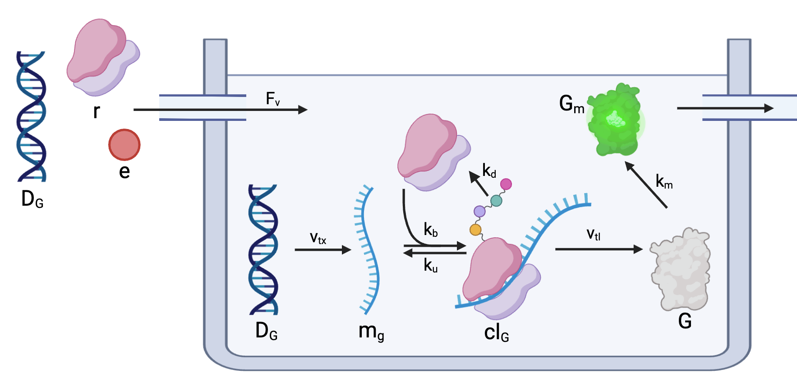

A simple cell-free system
Notes:
Energy, DNA and ribosomes are input into the system
DNA -> RNA -> GFP -> mature fluorescent protein
The system is diluted with fresh energy, DNA and ribosomes at discrete intervals
An equal volume is removed at each dilution interval

Slide 4
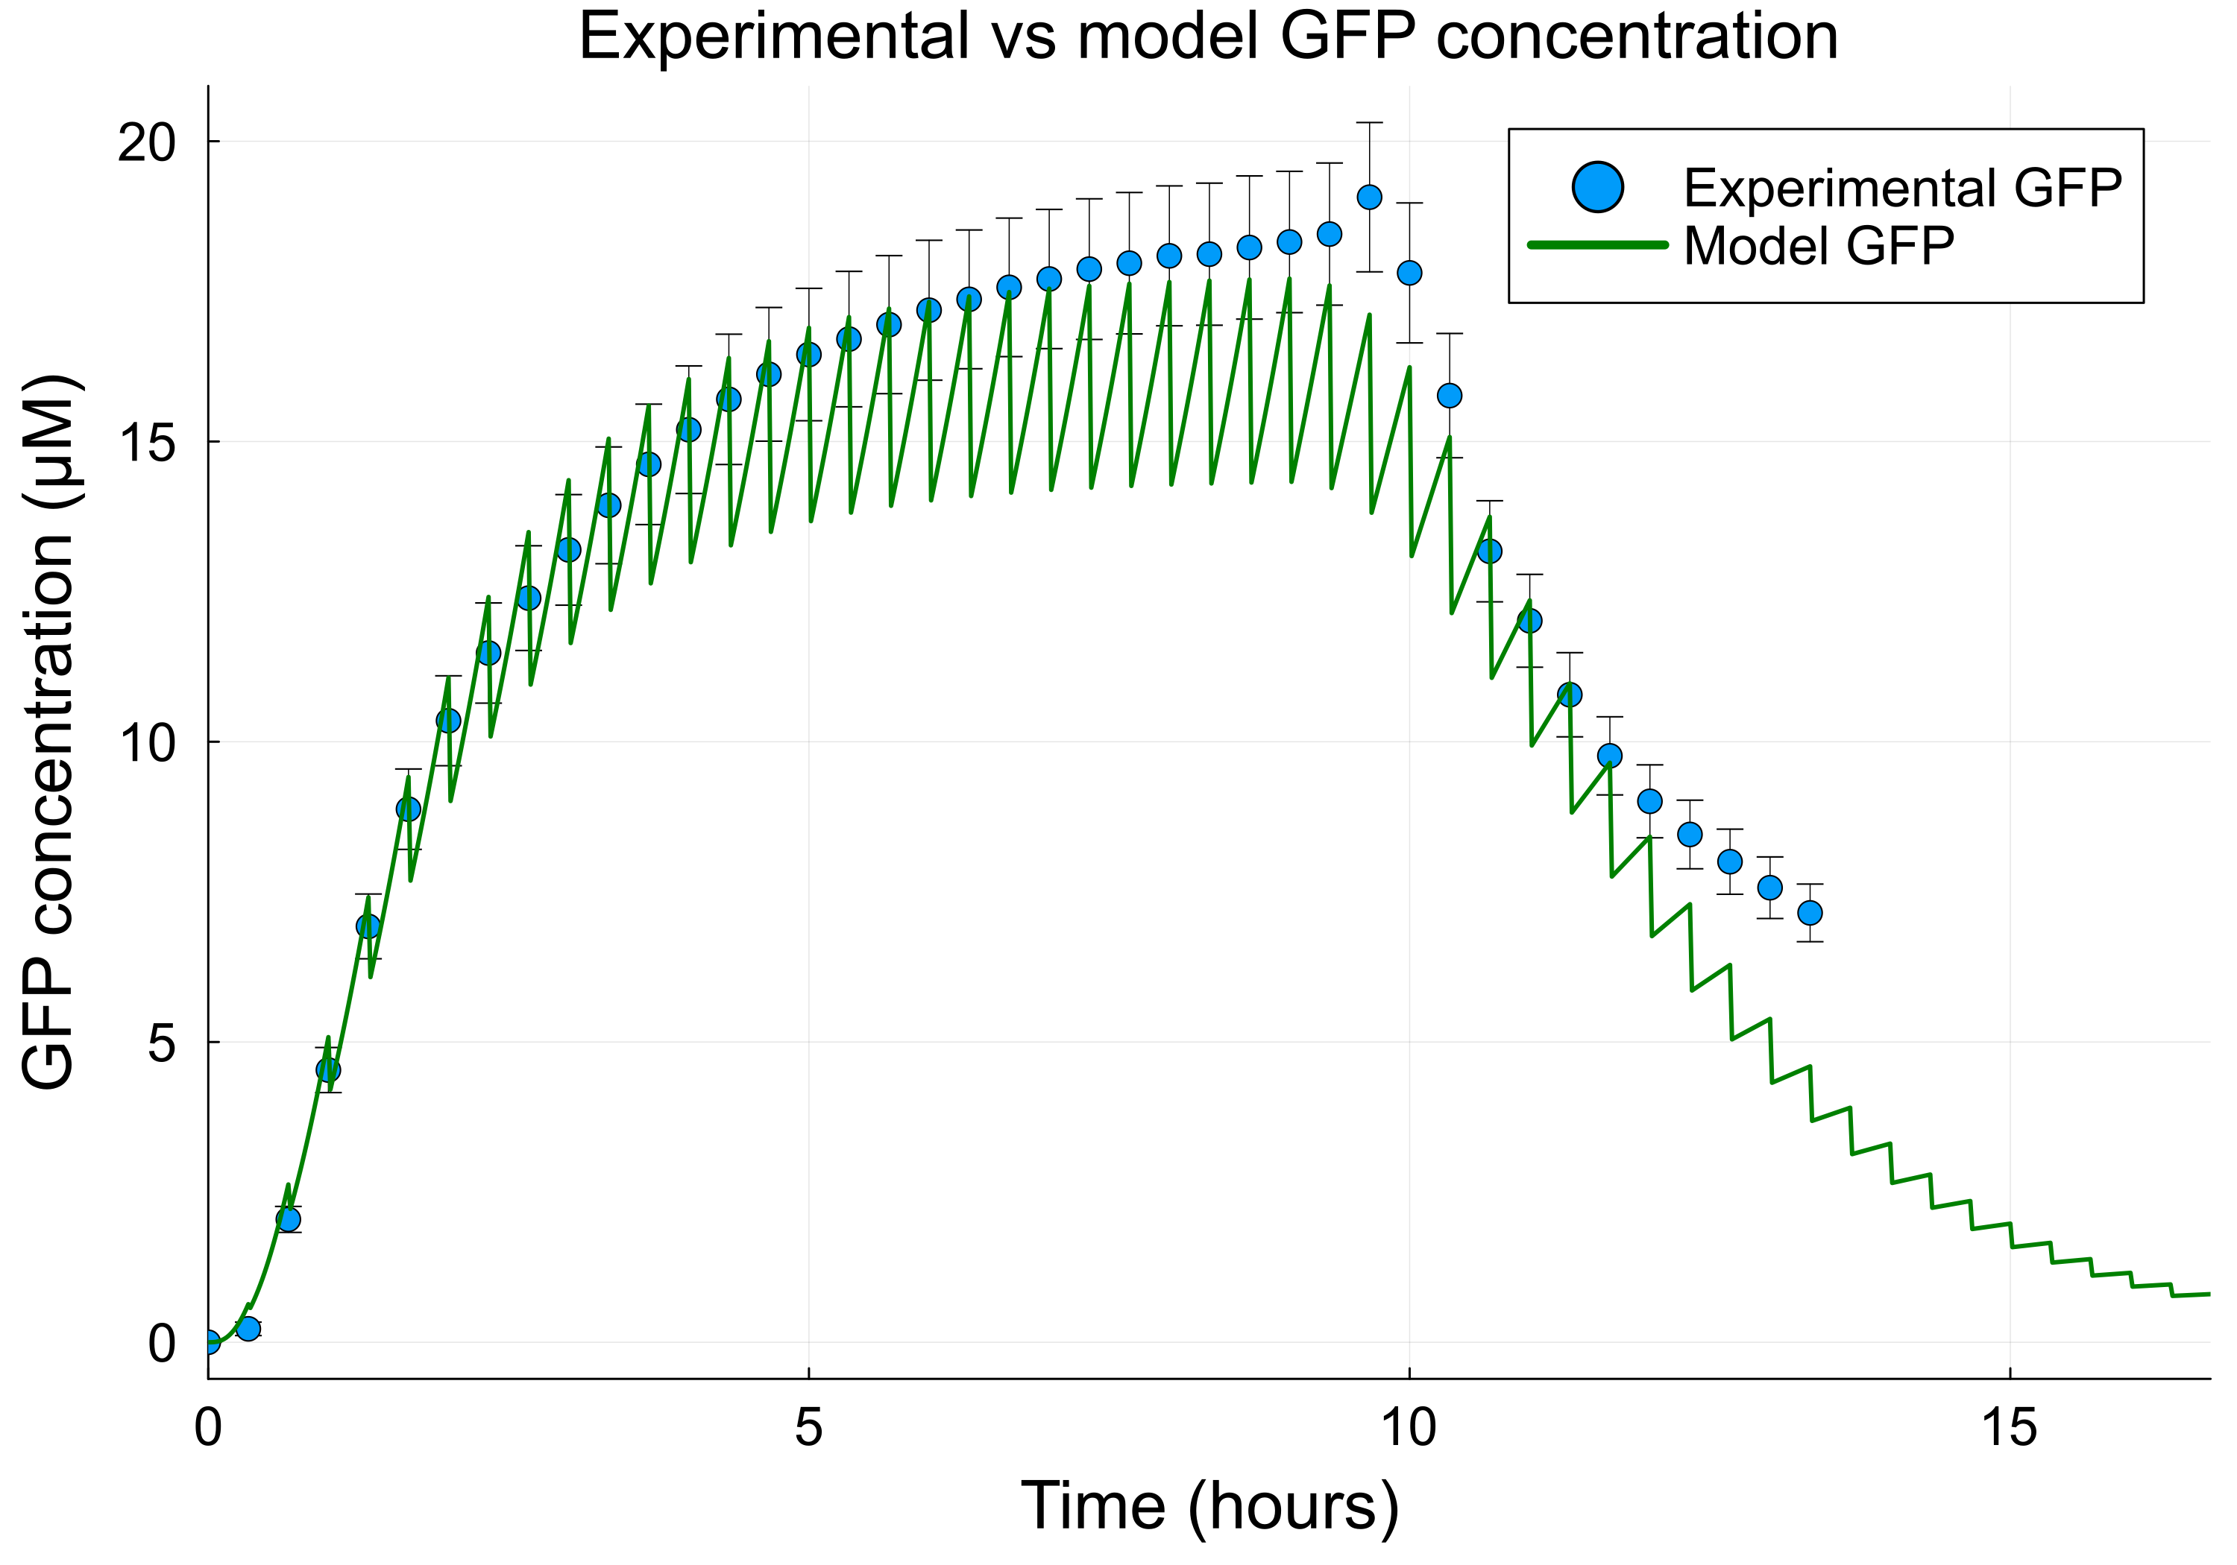
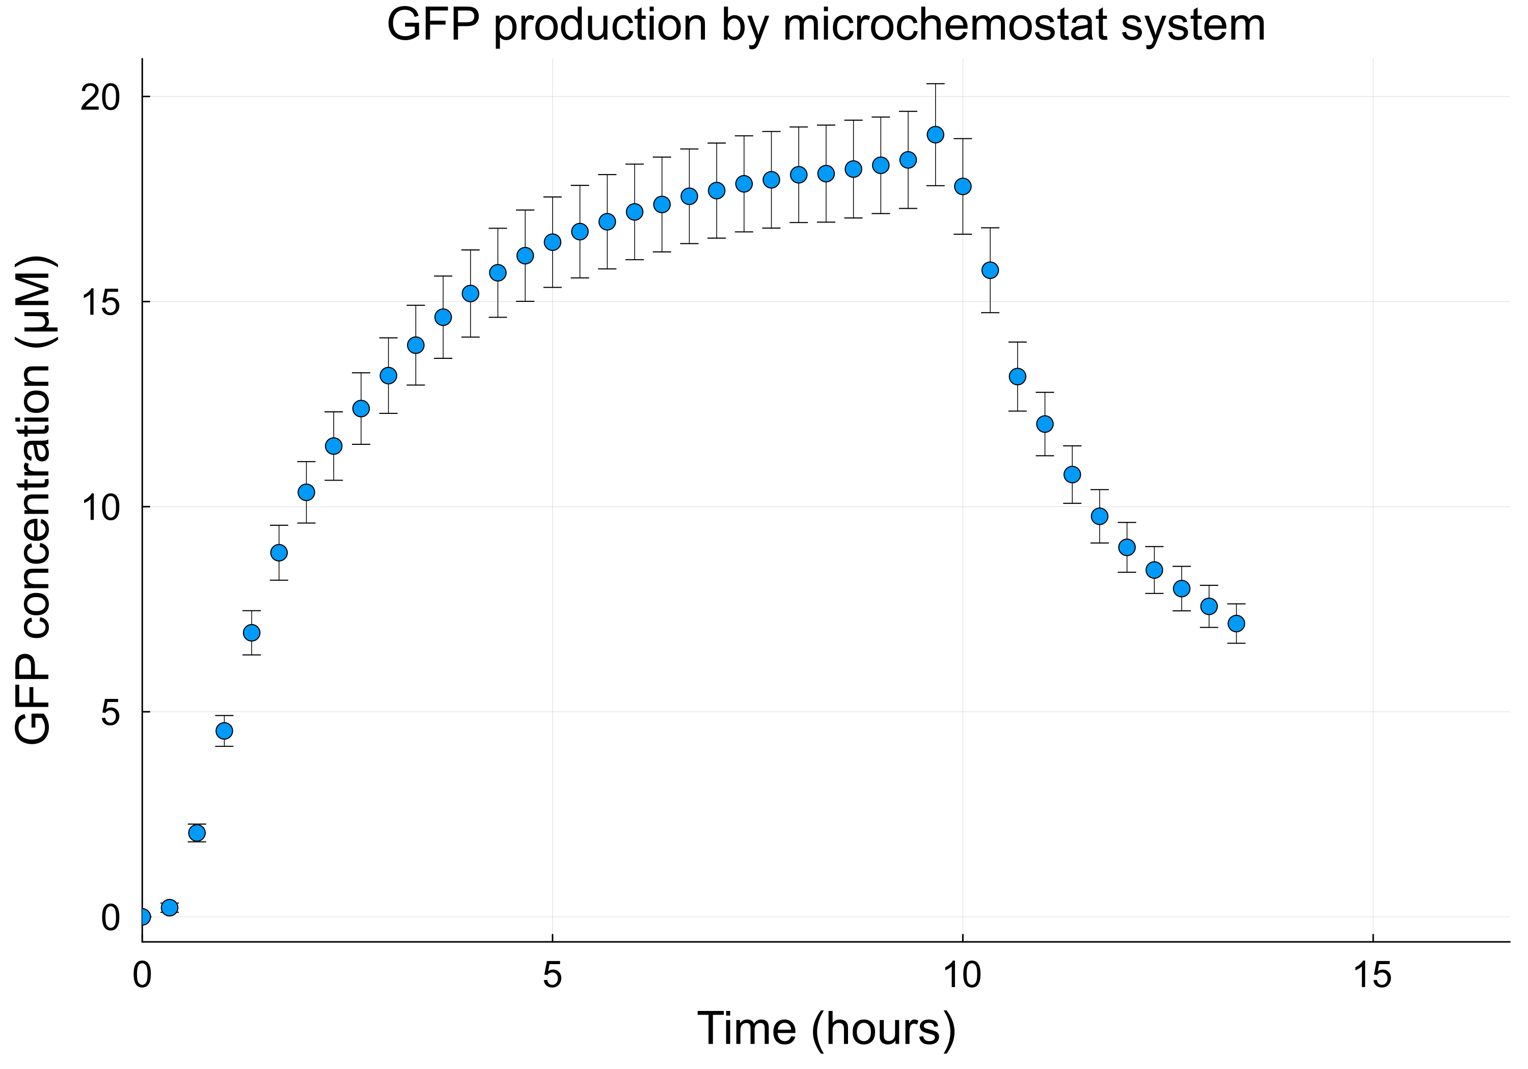


GFP production by chemostat
$$\frac{dG_{m}}{dt}=v_{tl}−μ∙G−μ⋅G_{m}$$
Notes:
GFP production from a microchemostat experiment
Washout phase at 9 hours – DNA is no longer added to each dilution

Slide 5

Optimization: where engineering meets biology
Notes:
Engineers optimize building materials for a bridge

Slide 6
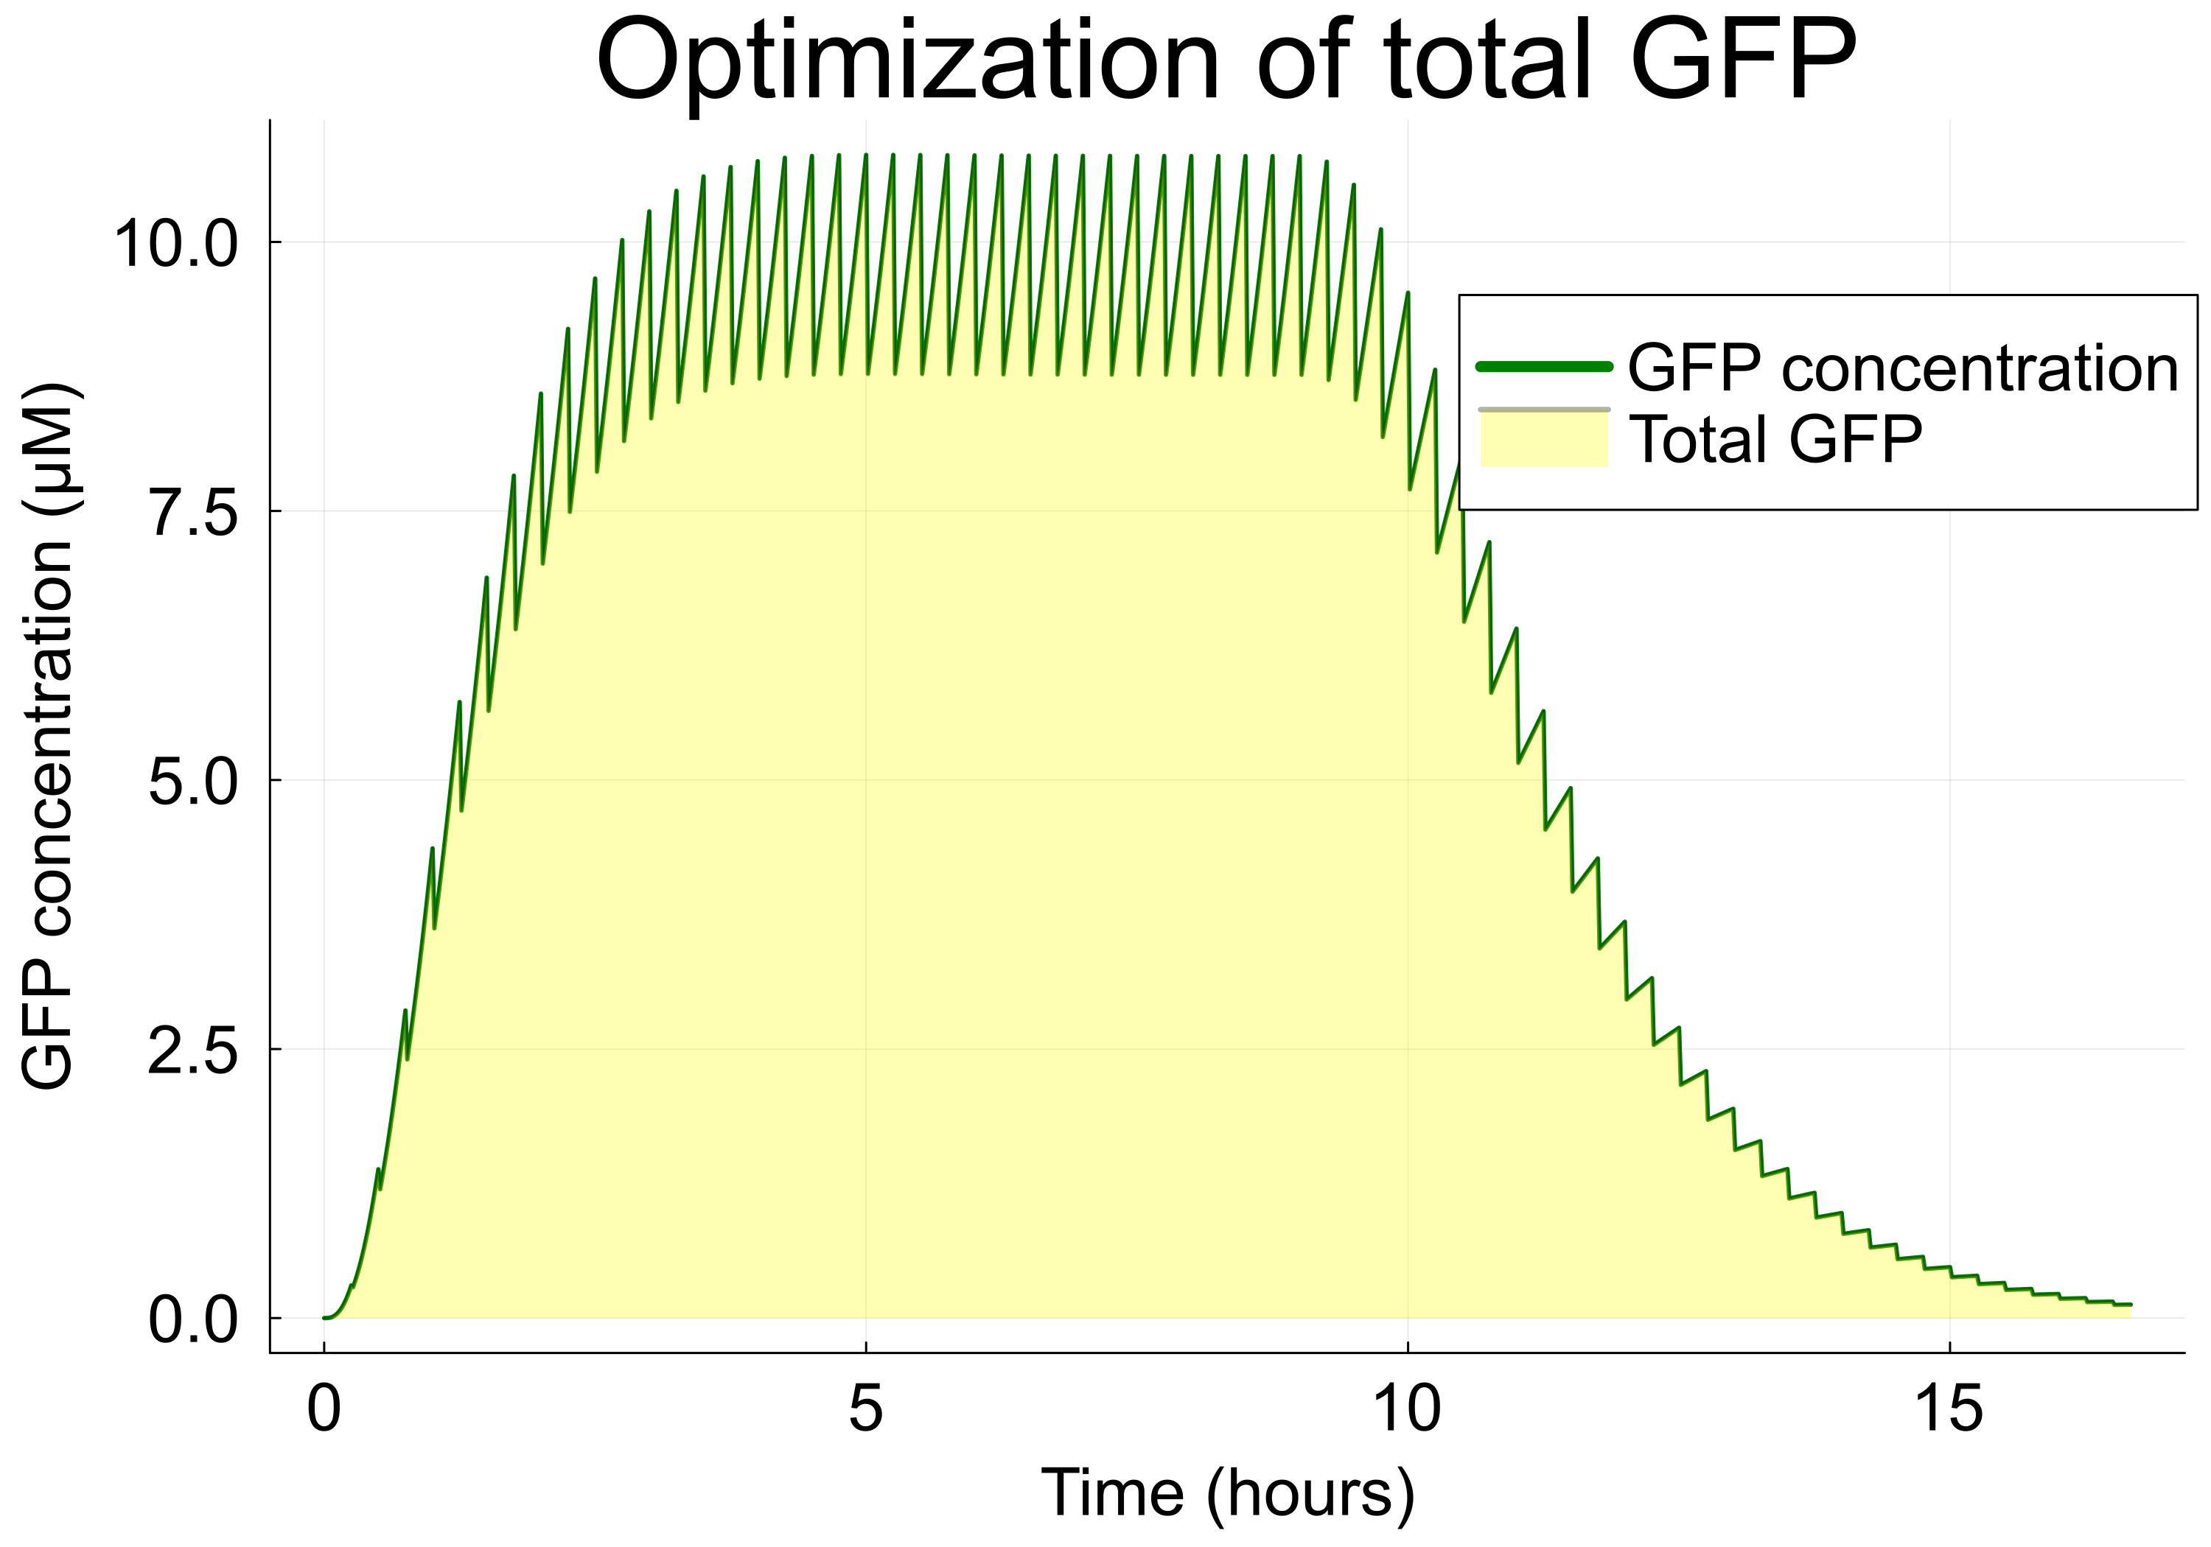
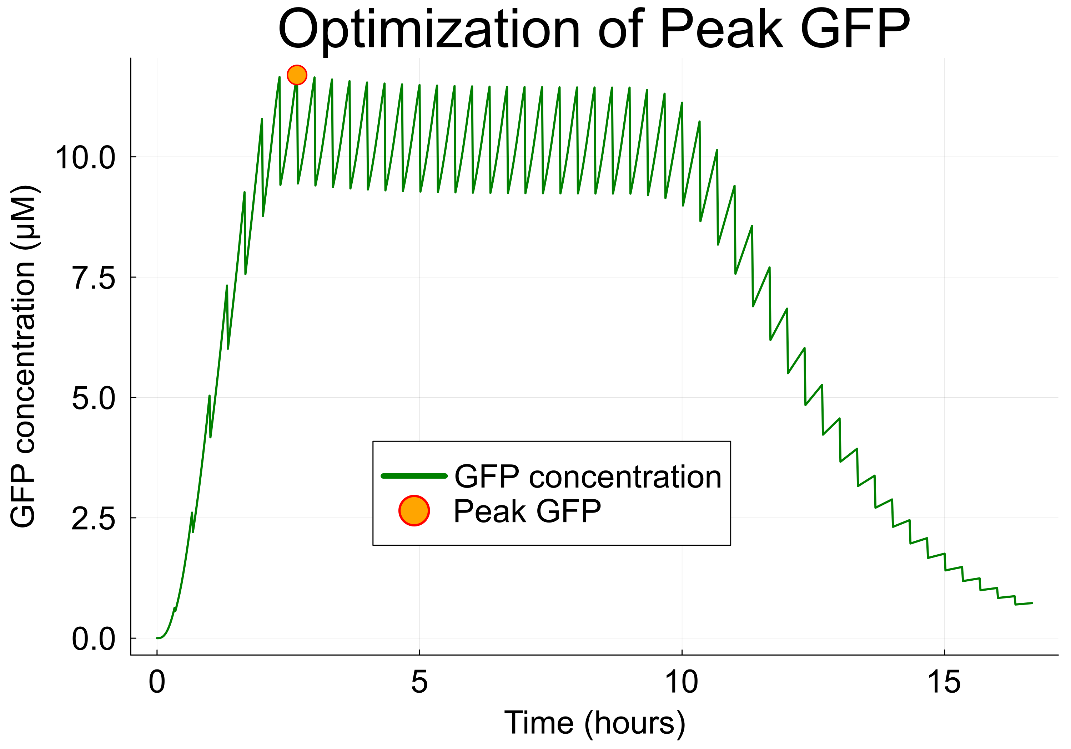
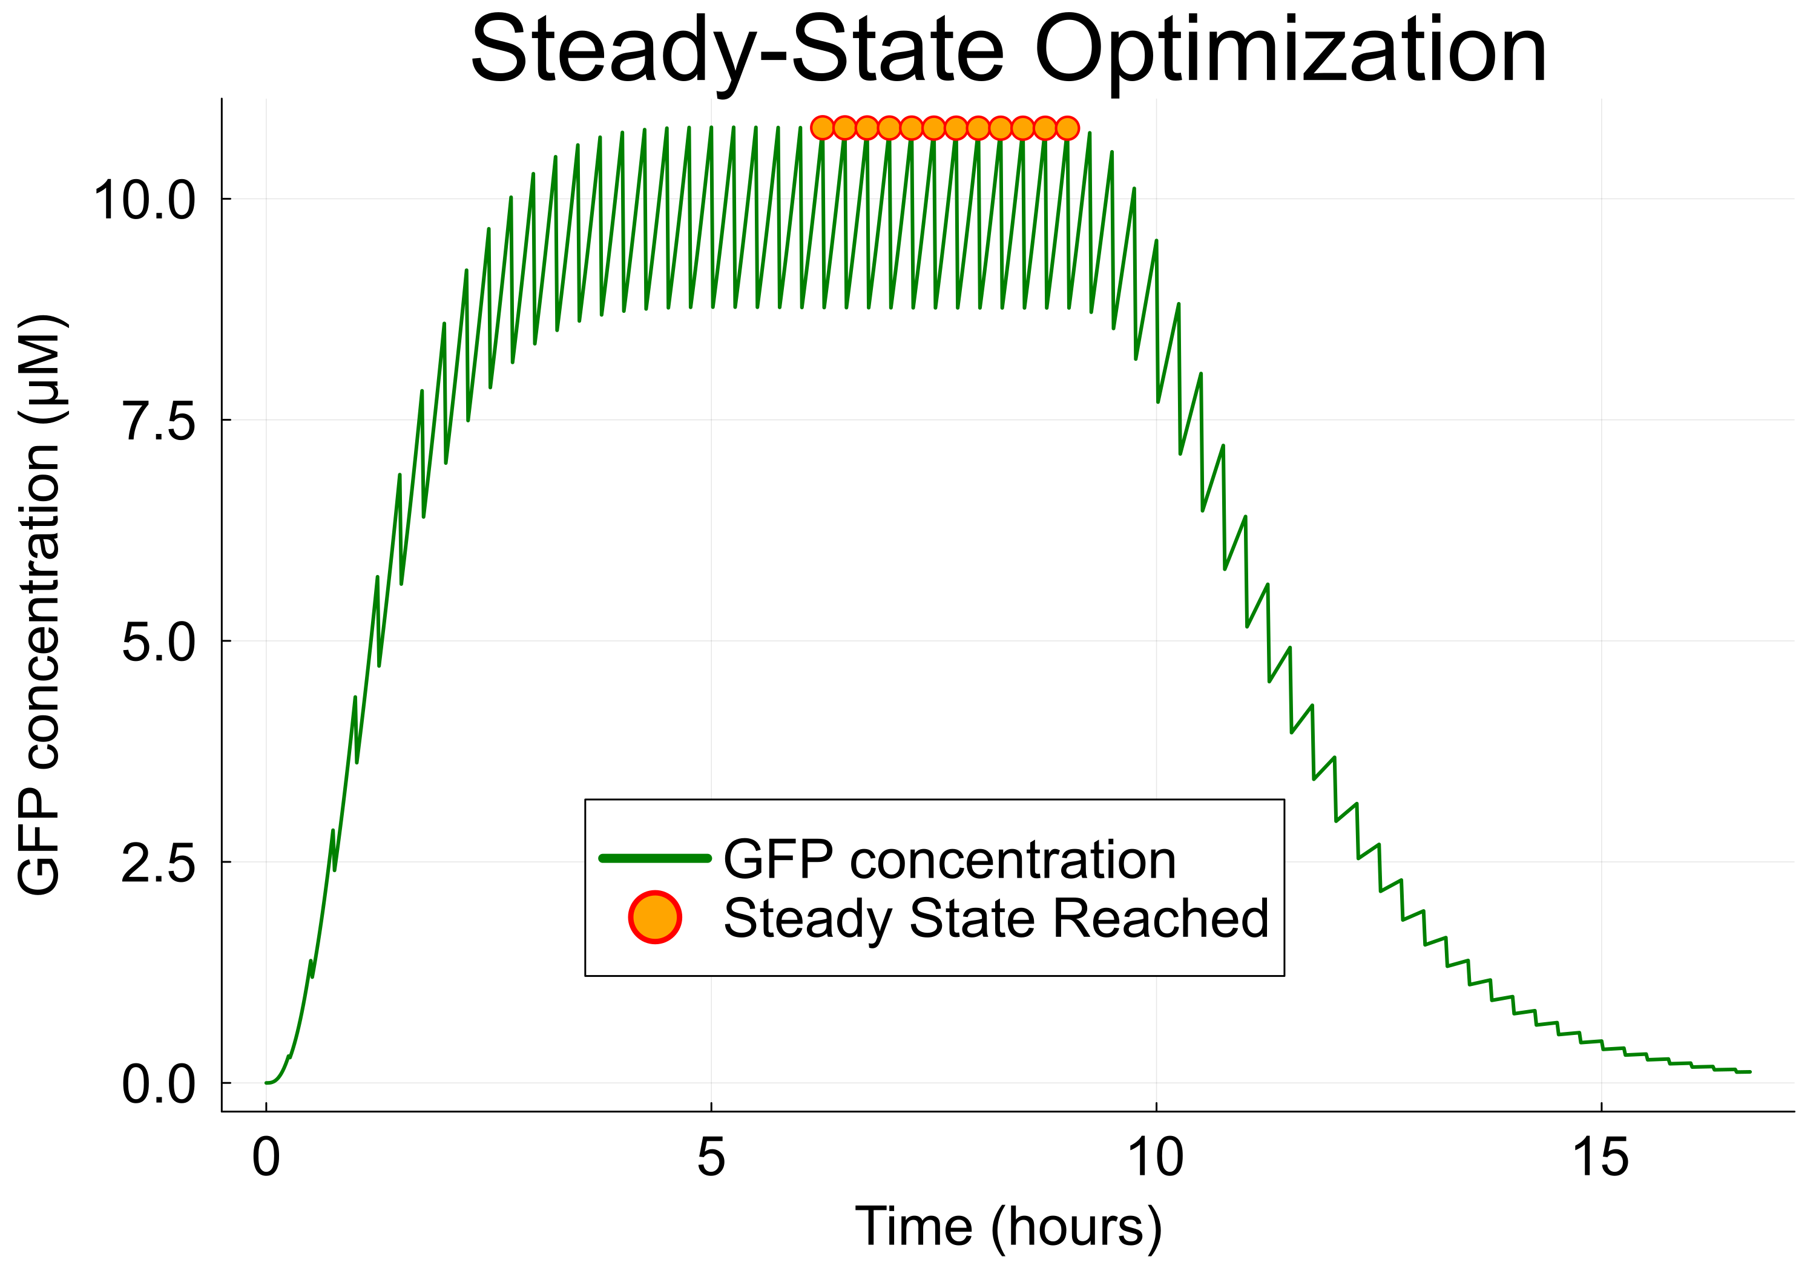
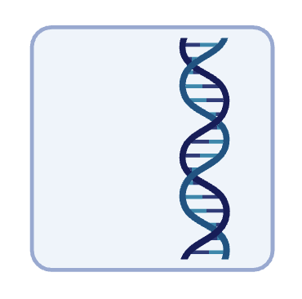
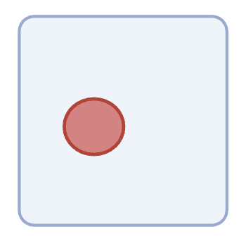
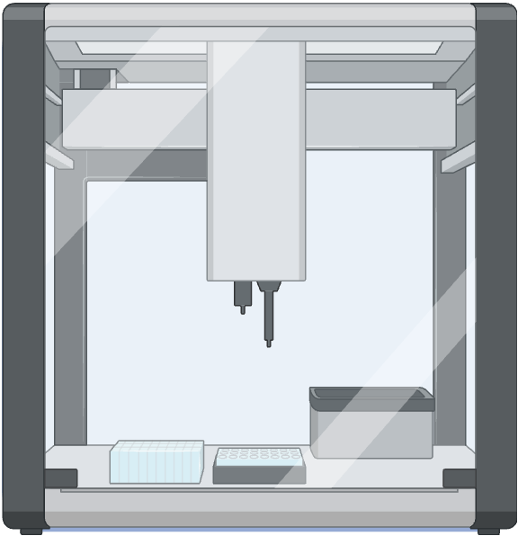
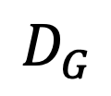
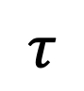
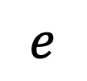
Optimizing cell-free protein synthesis
By changing:
Dilution interval
DNA
$$D_{G}$$
$$e$$
$$τ$$
Energy
Notes:
Total GFP yield – changing DNA, energy and dilution interval
Feed the integral of the Gm curve back into the algorithms
Improving bioreactor configuration and maximizing resource efficiency

Slide 7
Optimization algorithms
Initial guess $x_{k}$
Initial guess 𝑥_𝑘
Calculate solution at $x_{k}$
Calculate solution at 𝑥_𝑘
Move to new iteration $x_{k+1}$ based on these values
Move to new iteration 𝑥_(𝑘+1) based on these values
Continue iterations
Solutions converge on an optimum
Choose a direction and distance
Gradient-based algorithms
Use information about the derivatives of the objective function to move to the next iterations
Examples: gradient descent, Newton’s method, L-BFGS, interior point methods
Evolutionary algorithms
Inspired by Darwinian evolutionary systems
Iteratively evolve a population of candidate solutions over several generations
Use mutations, migrations and crossovers between solutions to converge on optimum values
Notes:
Optimization algorithms differ – method they use to move between points.
Gradient-based algorithms – derivatives of the objective function
Inform the step length (alpha) and direction (pk)

Slide 8
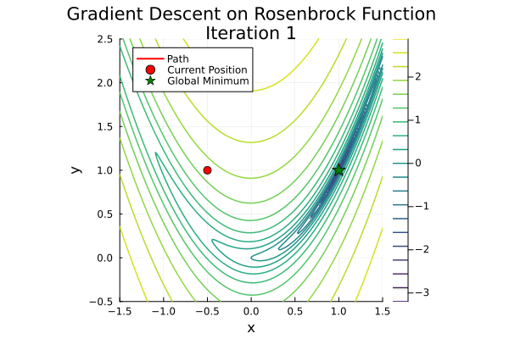

Optimization: comparing algorithms
Constructs a model function at each solution to guide distance and direction to next iterations
Each iteration moves in opposite direction to gradient
Notes:
Gradient descent – moves in opposite direction of the gradient to go to the next iteration
LBFGS – constructs a model function around each iterate – simulate the second derivative – curvature of the function
Speed of solutions

Slide 9
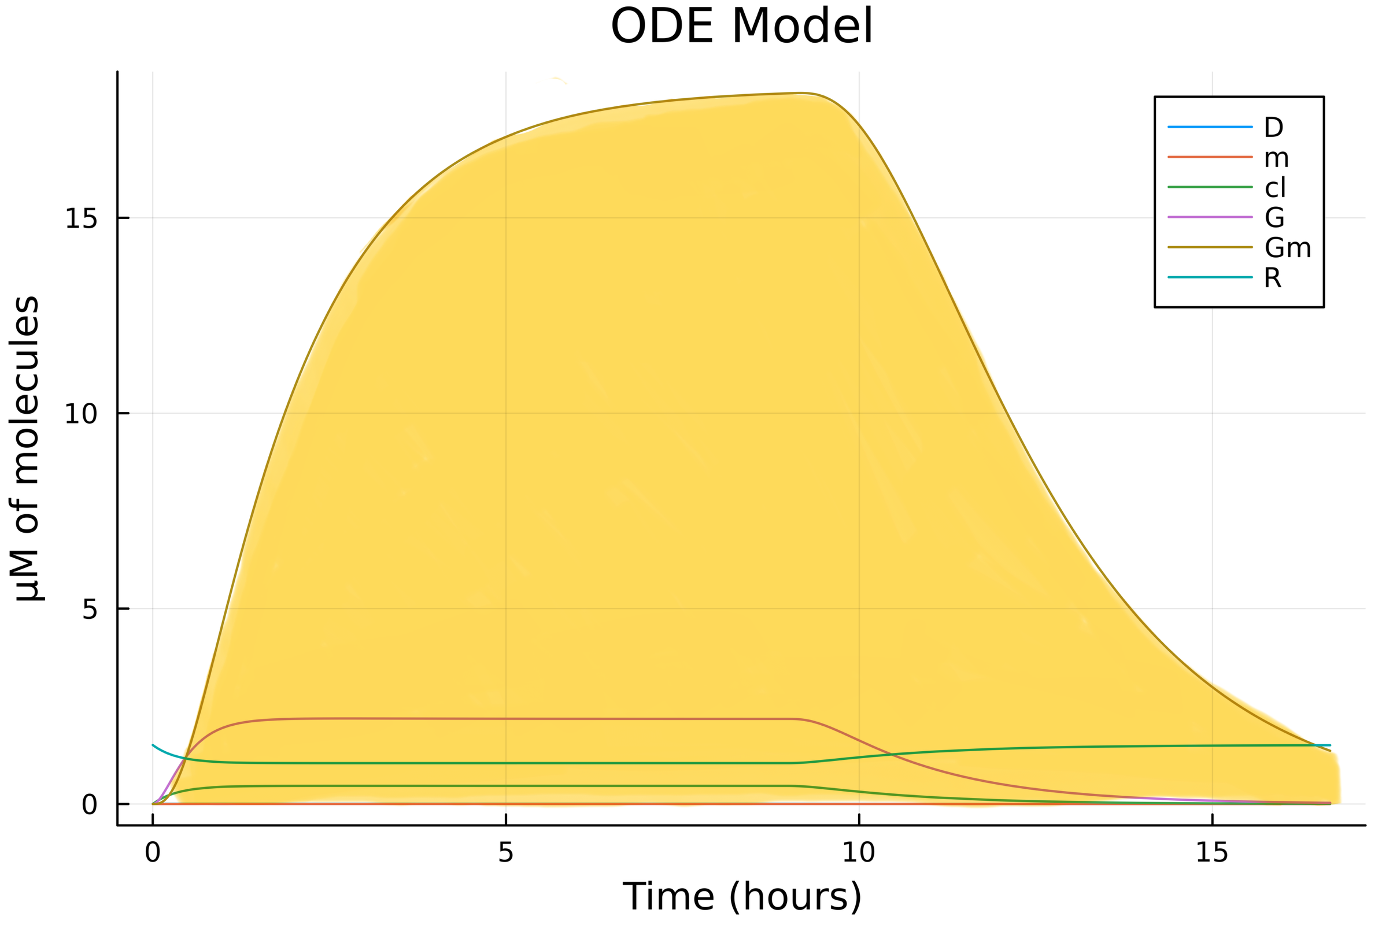
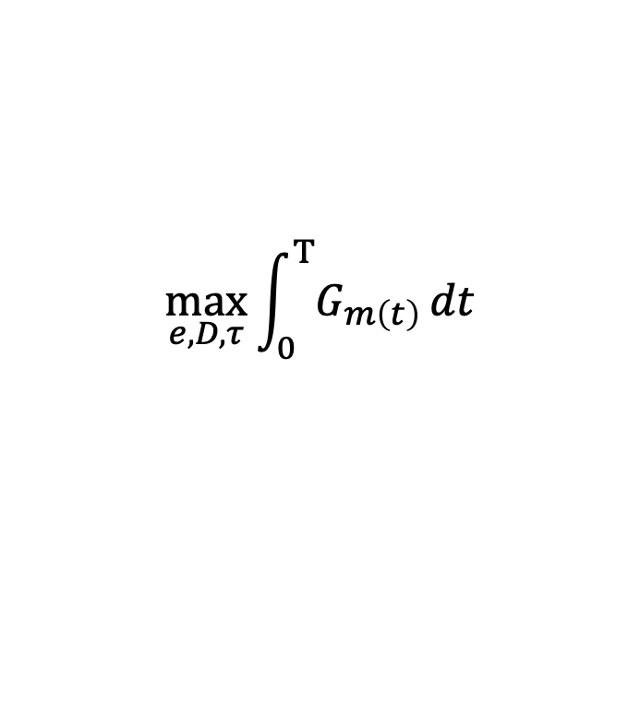
Cell-free optimization: maximizing total yield
Improve bioreactor configuration
Maximum resource efficiency
High-yield sustained protein synthesis over time
Bulk chemicals, therapeutic proteins etc.
$$\max_{e,D, τ}{\int_{0}^{Τ}{G_{m\left(t\right)}}}dt$$
Notes:
Total GFP yield – changing DNA, energy and dilution interval
Feed the integral of the Gm curve back into the algorithms
Improving bioreactor configuration and maximizing resource efficiency

Slide 10
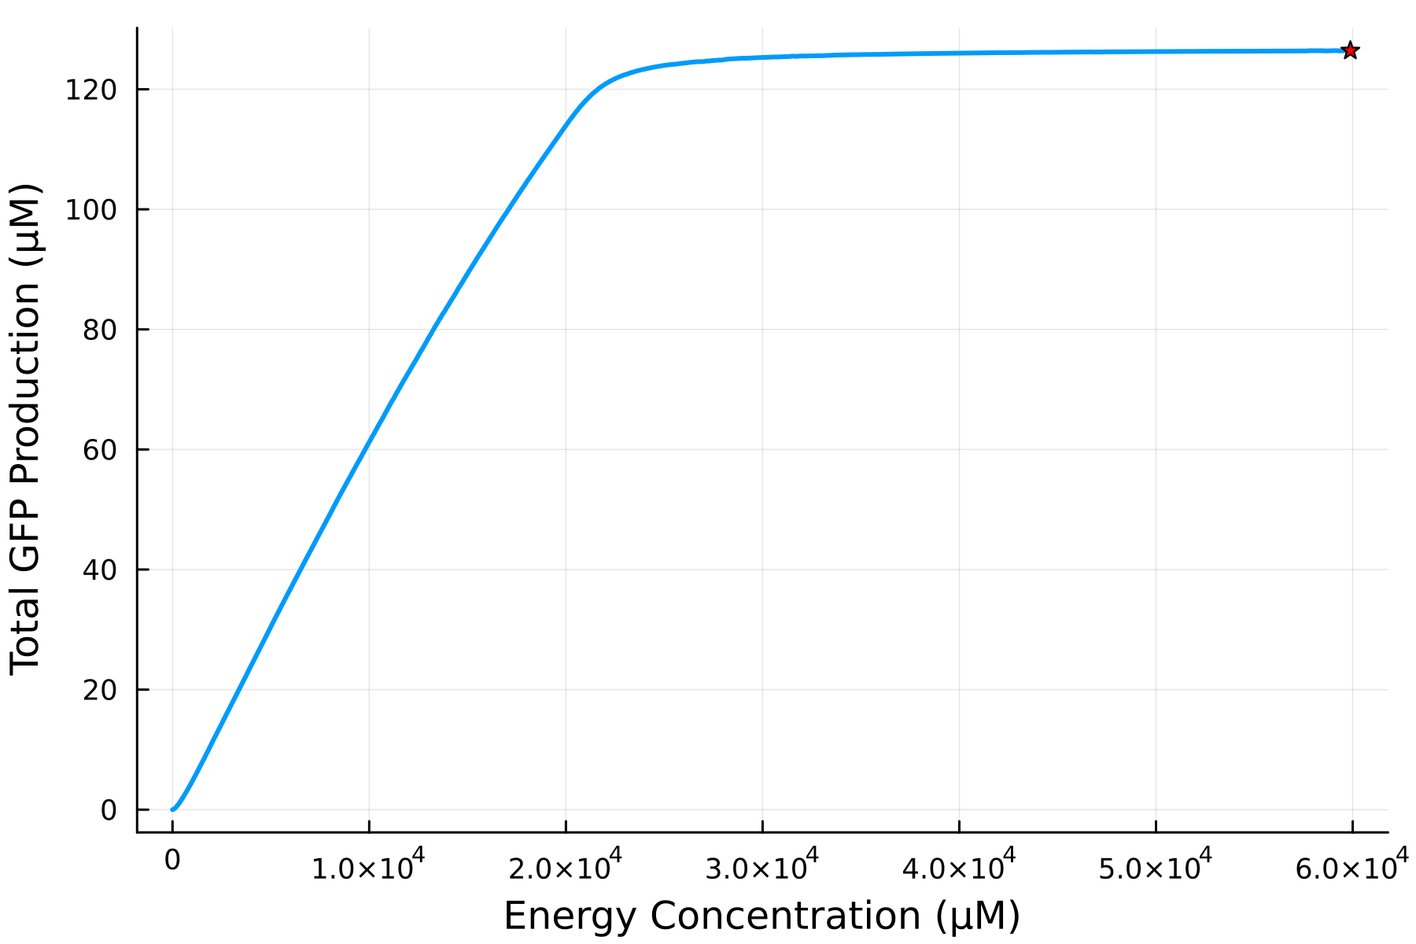
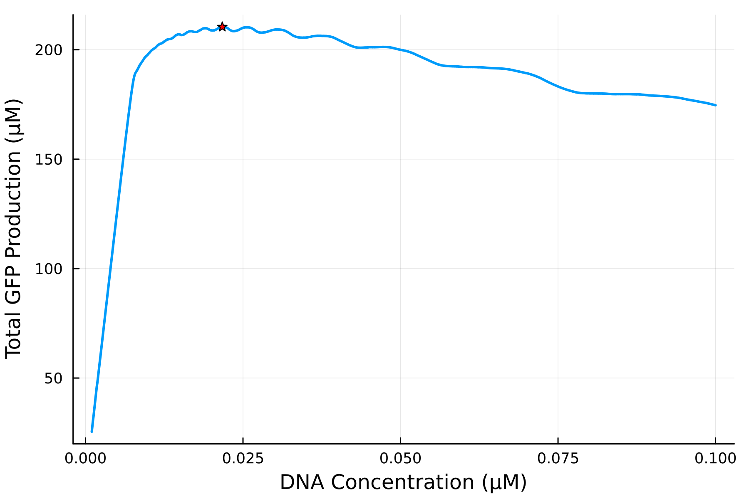
Optimizing DNA and energy for maximum total yield
Effect of energy concentration on total GFP
Effect of DNA concentration on total GFP
Total GFP concentration (µM)
Total GFP concentration (µM)
Energy Concentration (µM)
DNA Concentration (µM)
Notes:
Maximum energy concentration -> greatest total GFP yield
Higher DNA concentration -> more energy channeled into transcription than translation.
Nelder-Mead algorithm struggled for one dimensional problems
Algorithm can only move along a single straight line in search of improved solutions
All the other algorithms we tried performed well

Slide 11
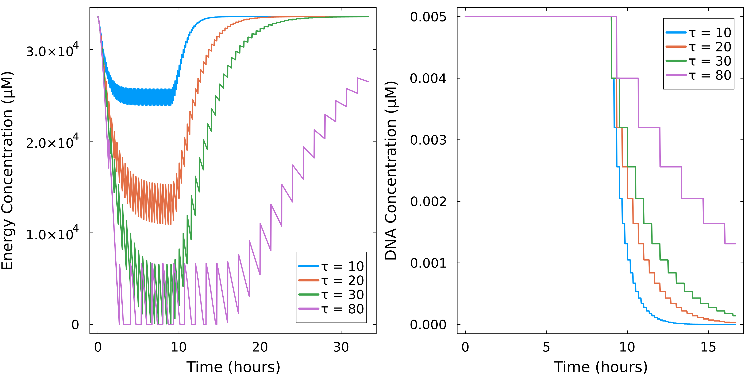
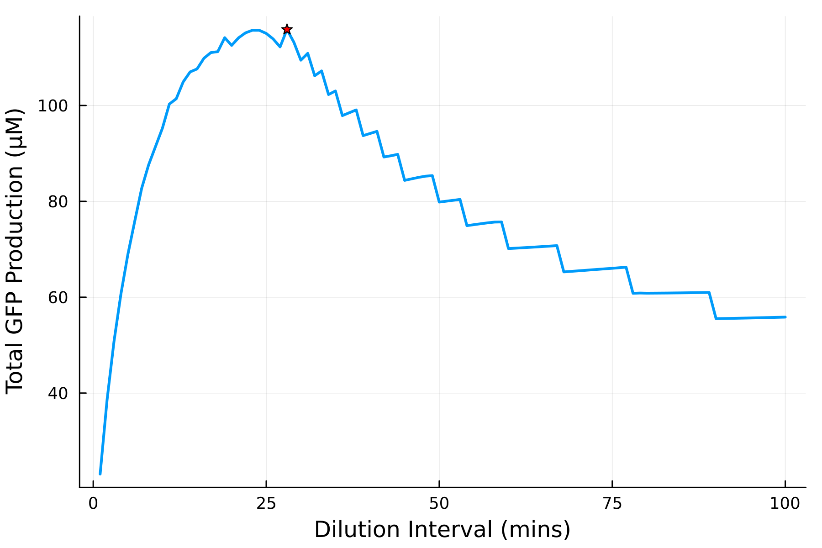
Optimizing dilution interval for maximum total yield
Energy concentration over time at different dilution intervals
Effect of dilution interval on total GFP
Total GFP Produced (µM)
Energy Concentration (µM)
Dilution interval (minutes)
Time (hours)
Gradient-based algorithms struggled due to the discrete nature of the dilution interval
Notes:
Short dilution intervals -> failed to fully consume energy and mRNA before dilution
Long dilution intervals -> leave DNA in the system for longer after the washout phase -> but periods of complete energy depletion
Gradient-based optimization algorithms -> fail -> discrete nature of the dilution intervals

Slide 12
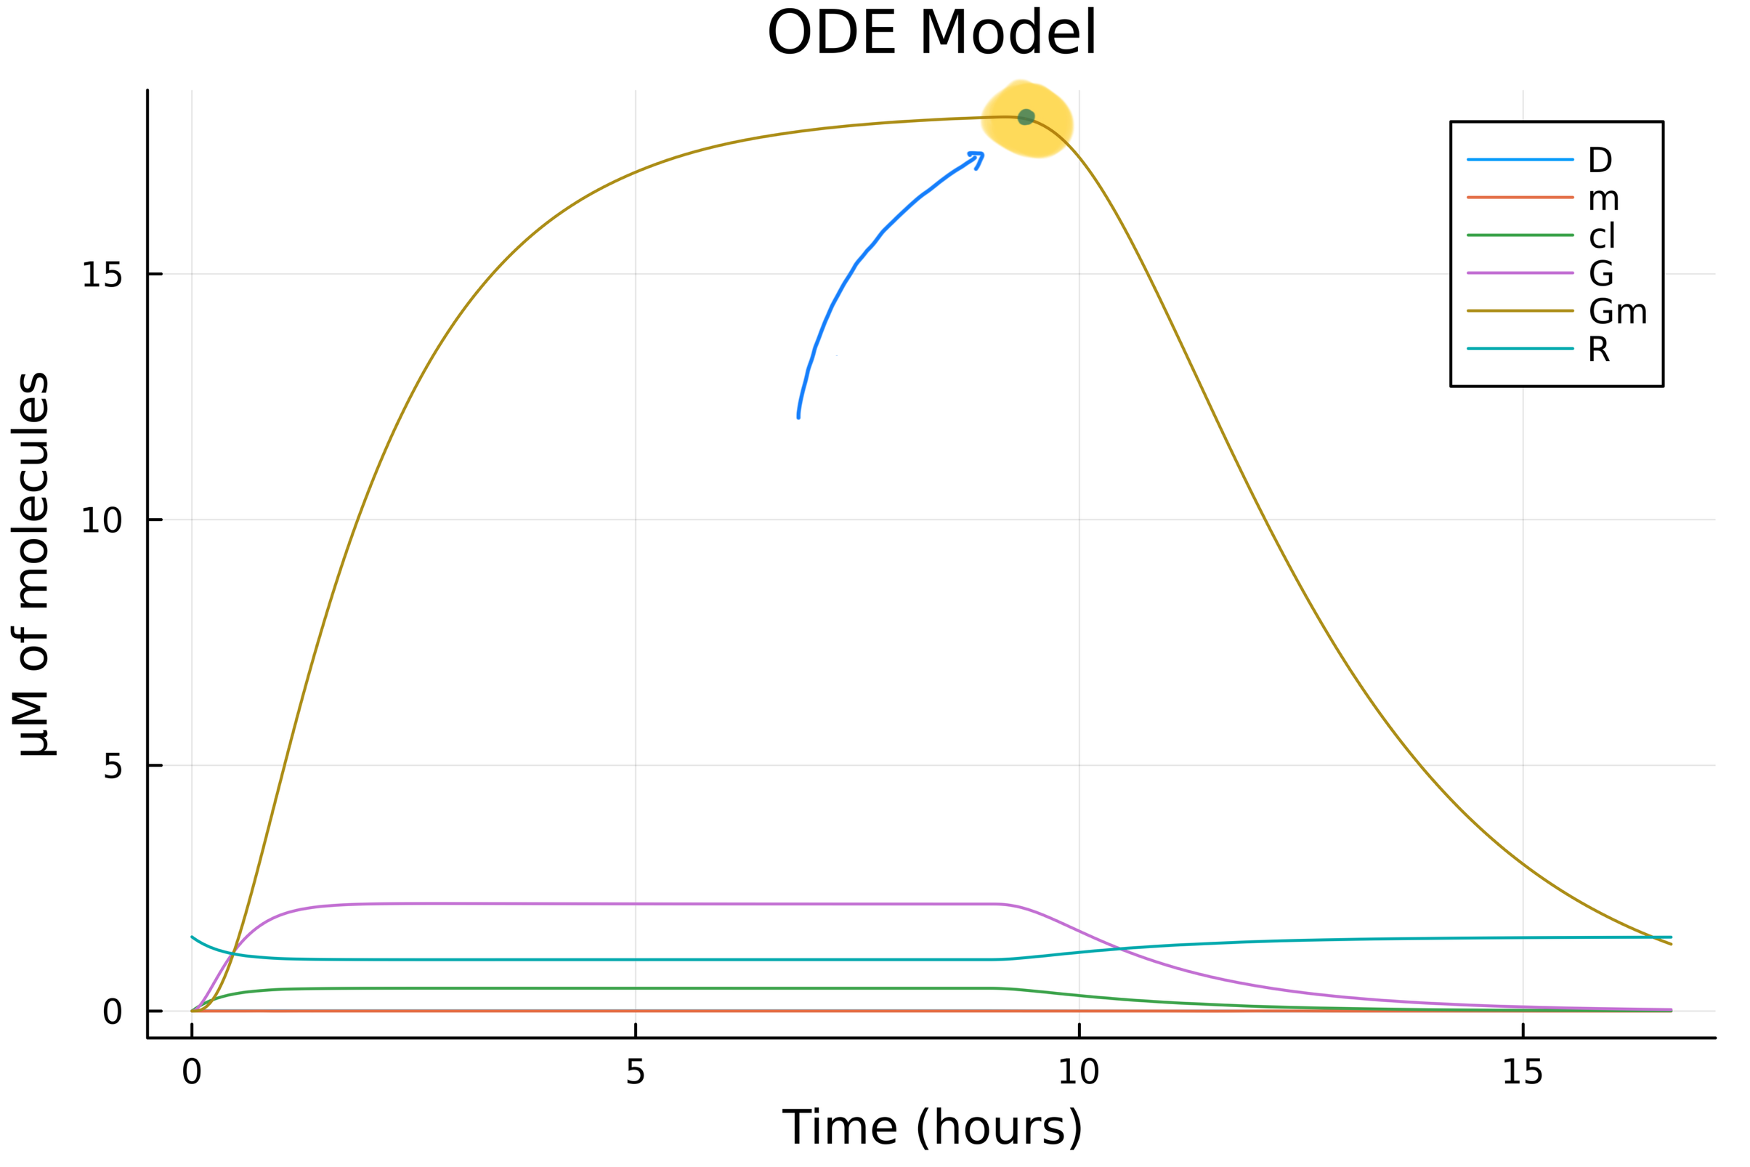
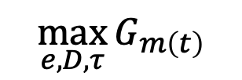
Cell-free optimization: peak GFP concentration
Improving signal-to-noise-ratio for diagnostic tools
Detection of biomarkers and pathogens
Measurable signals for high-throughput screening applications.
$$\max_{e,D, τ}{G_{m\left(t\right)}}$$
Notes:
Maximum peak GFP – change energy, DNA and dilution interval
Feed peak mature Gm value back into the optimization algorithms.
Diagnostic tools -> intense signal to be detected above background noise
High-throughput screening applications – clear outputs that can be easily detected.

Slide 13
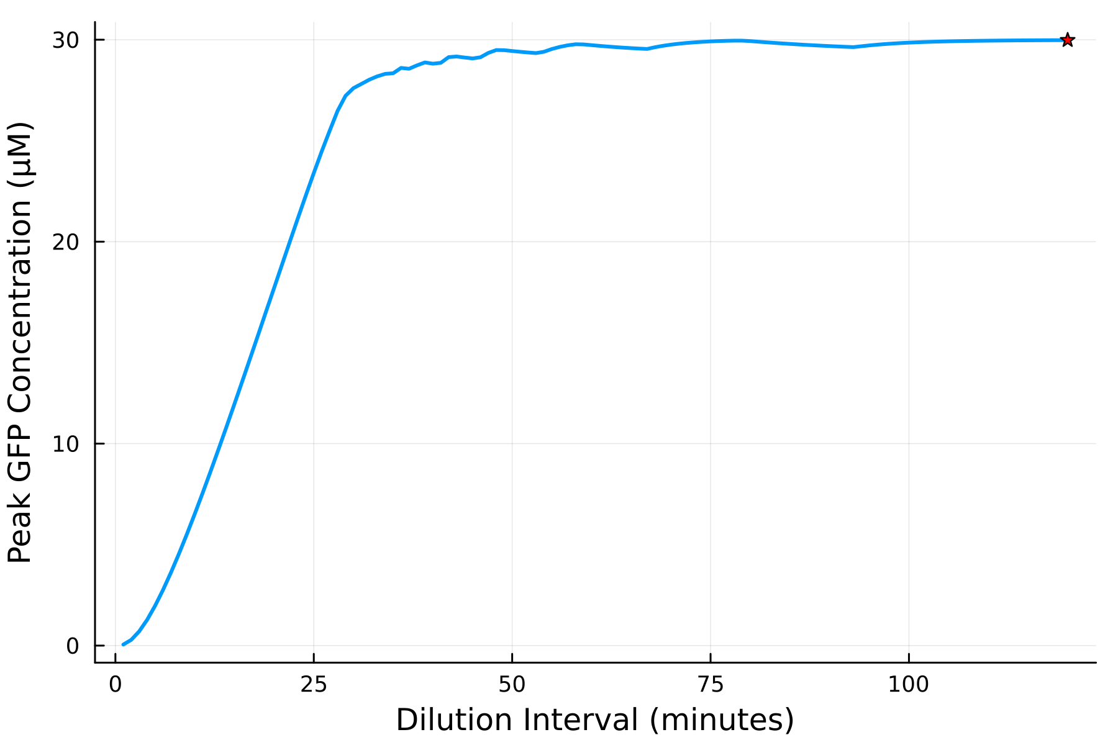
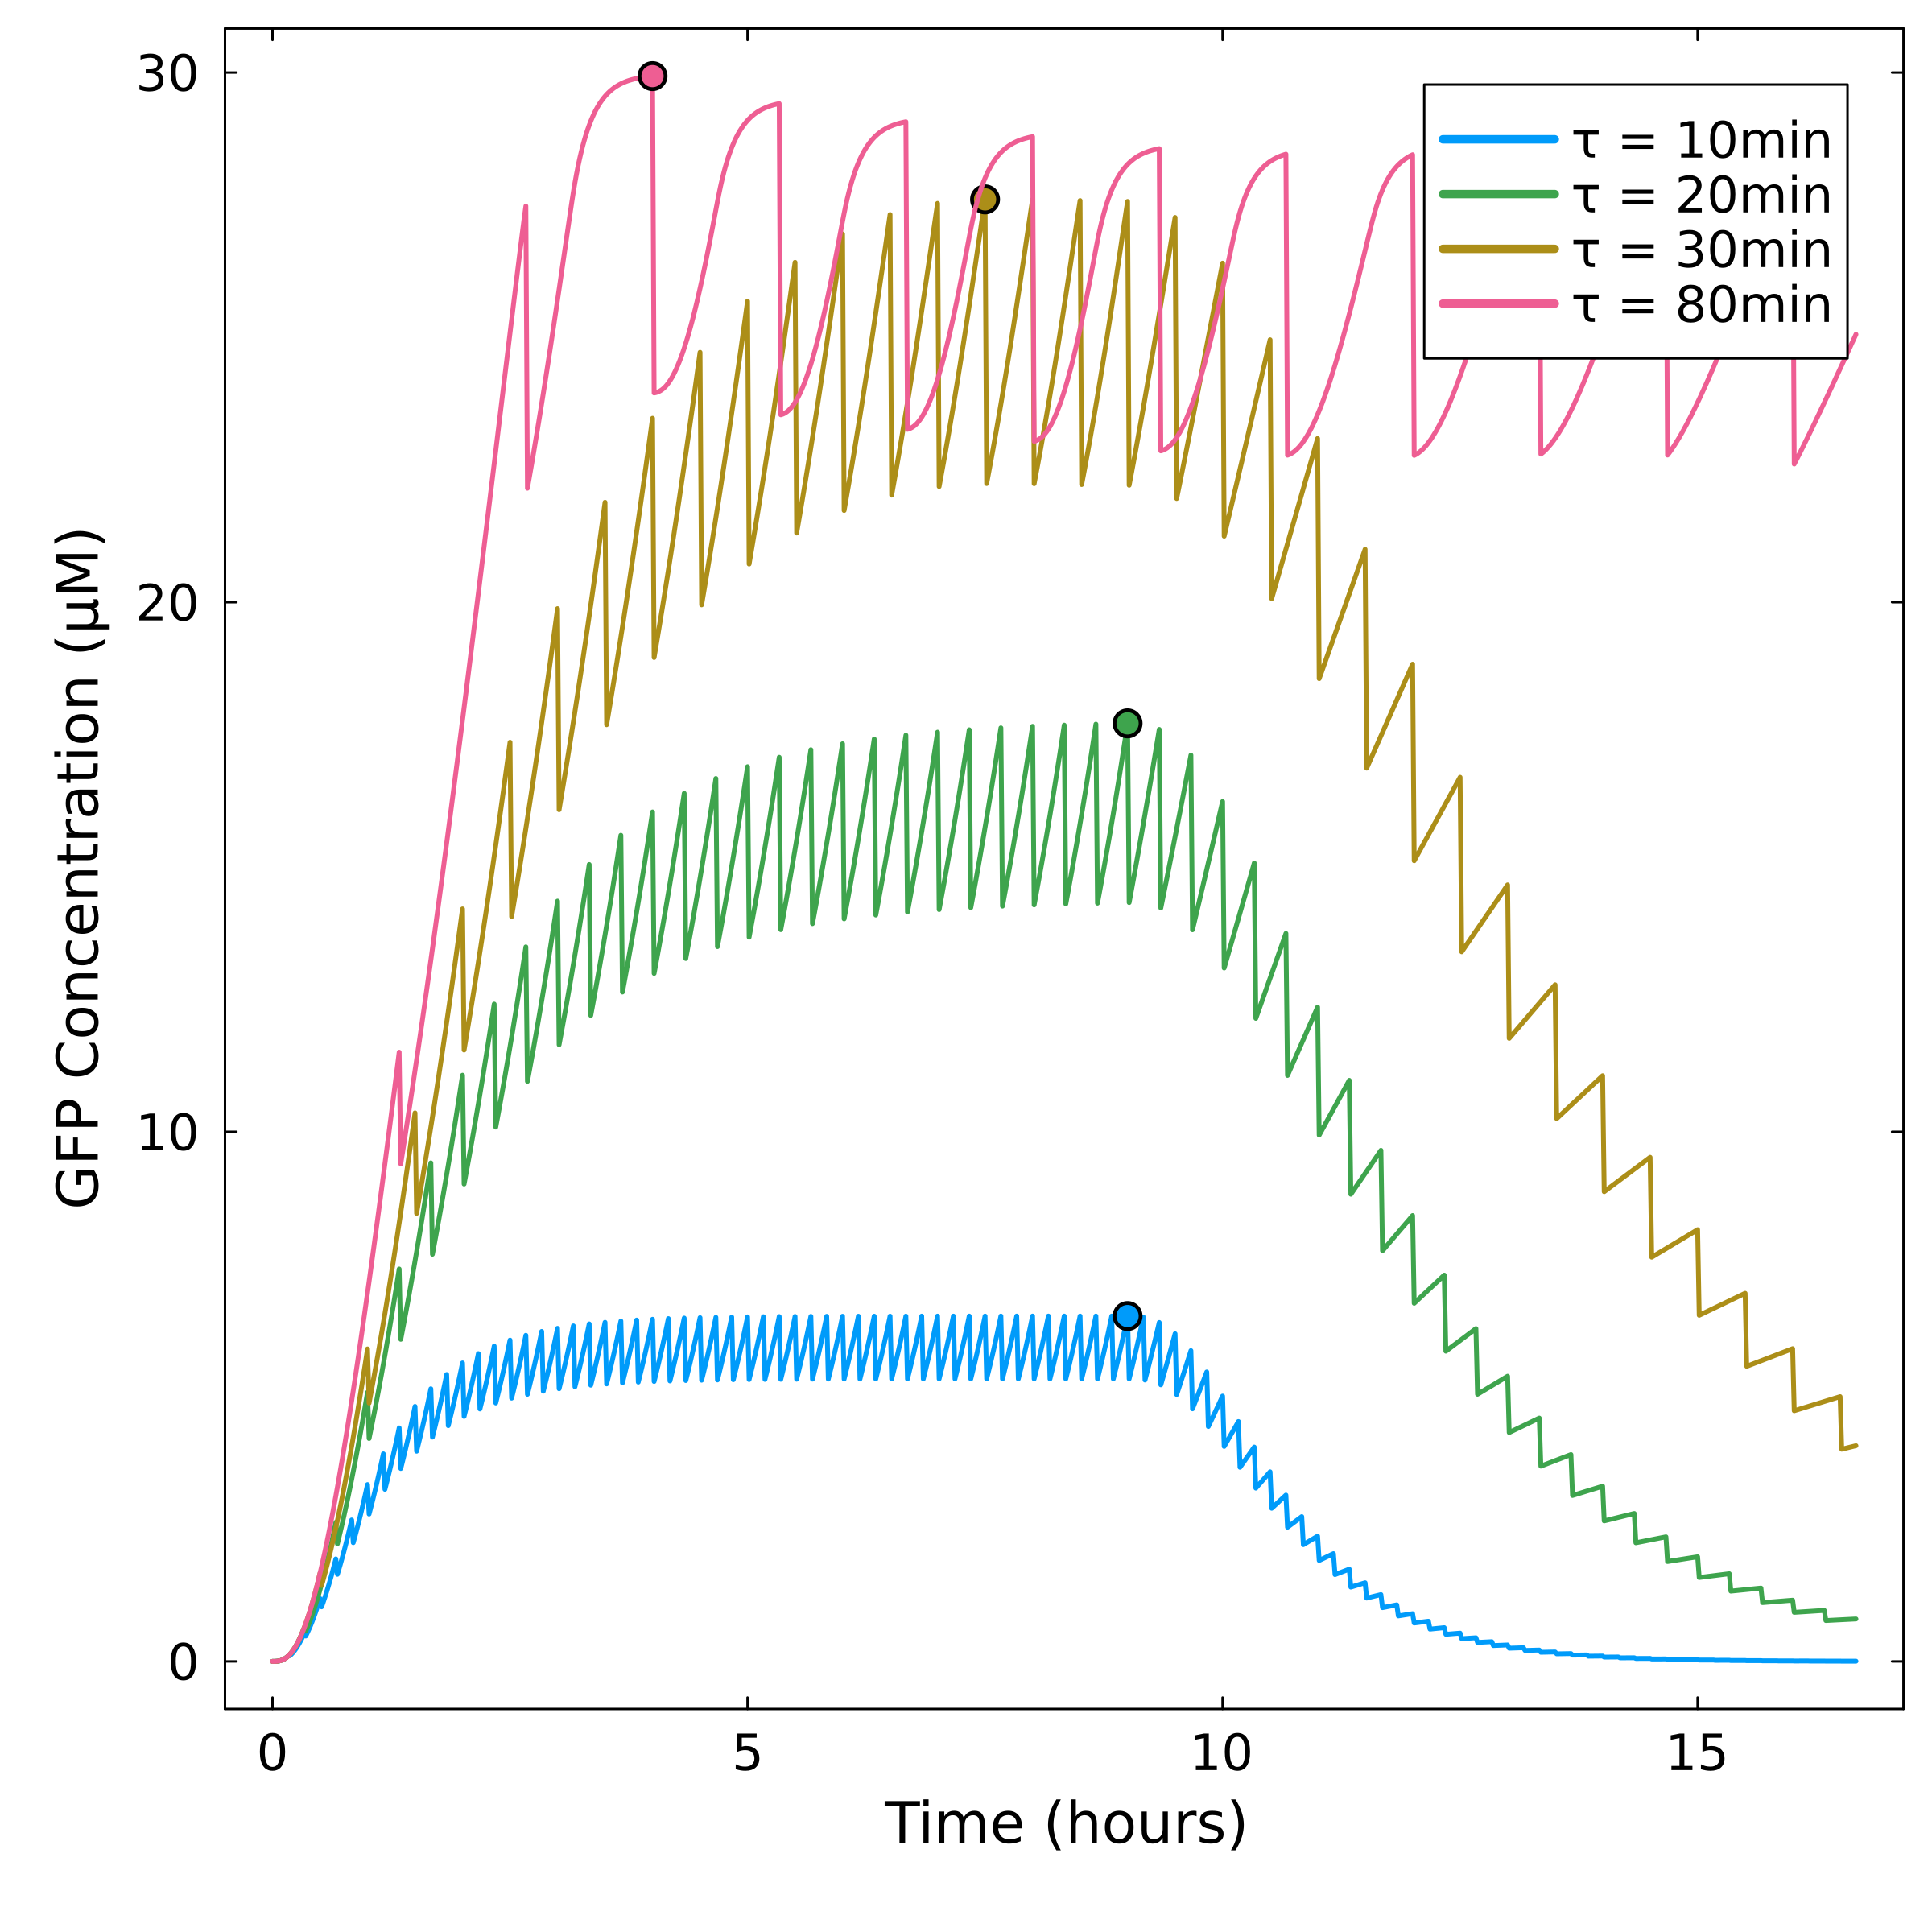
Cell-free optimization: peak GFP concentration
Effect of dilution interval (τ) on the peak GFP concentration
GFP concentration over time at different dilution intervals
Peak GFP Concentration (µM)
GFP Concentration (µM)
Dilution interval (minutes)
Time (hours)
Notes:
High energy concentration -> higher peak GFP concentration.
Optimum DNA -> slightly lower
Longer dilution interval – all energy and RNA can be used in the first few cycles – sharp initial increase before steady-state

Slide 14
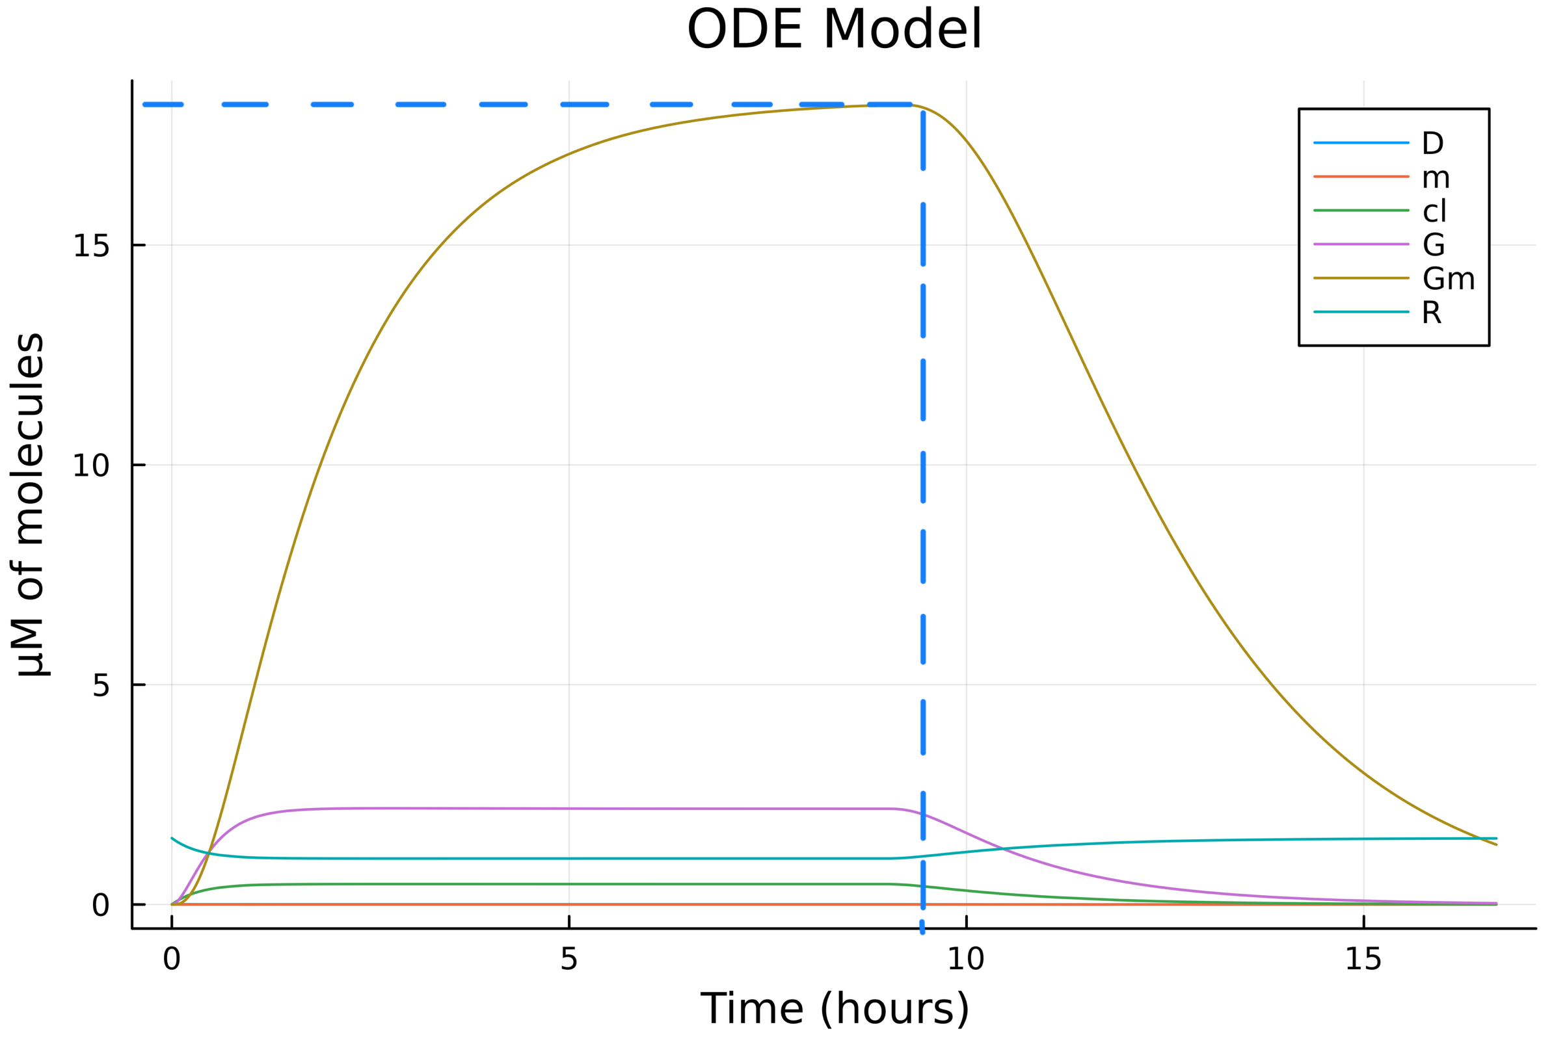

Optimizing a cell-free system
Cell-free optimization: steady-state
Minimizing reactor ‘downtime’ and reducing batch length
Importance of speed in diagnostic applications
System robustness
Notes:
Minimize time taken to reach steady state
Maximize the GFP concentration at steady state
Calculate maximum concentration change between each dilution cycle
Concentration change less than 1% -> steady state

Slide 15
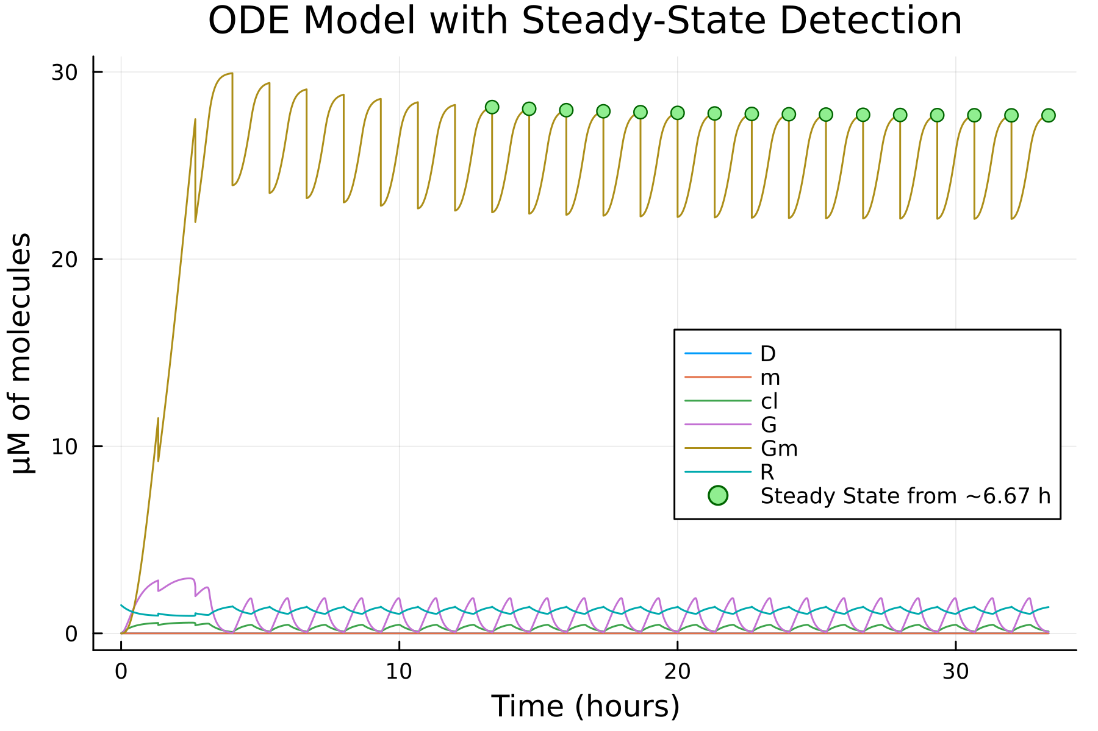
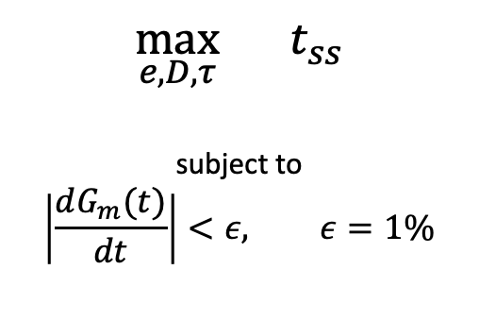
Optimizing a cell-free system
Cell-free optimization: time taken to reach steady-state
ODE Model With Steady State Detection
$$\max_{e,D, τ}{t_{ss}}$$
subject to
$$\left|\frac{dG_{m}(t)}{dt}\right|<ε, ε=1\%$$
Notes:
Lacked accuracy (flatlines)
SS only detected after a full cycle (or multiple cycles depending on how strict the conditions supplied to the algorithm are) have occurred
Various objective values lead to same time taken to reach steady state.

Slide 16
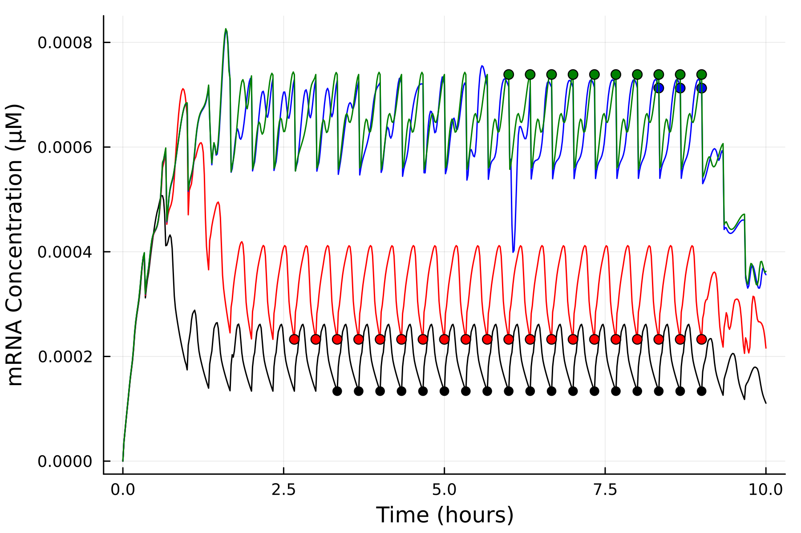
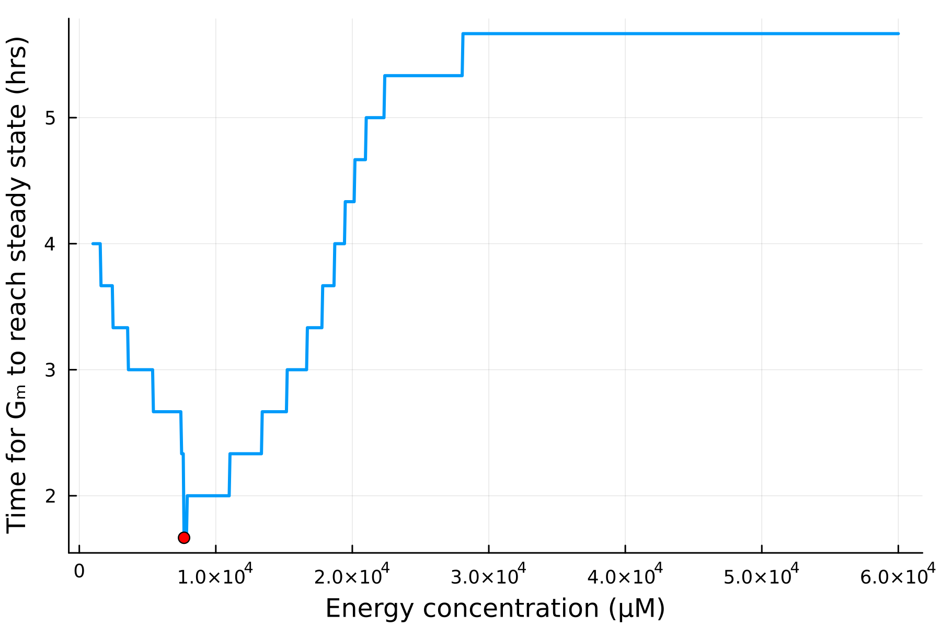
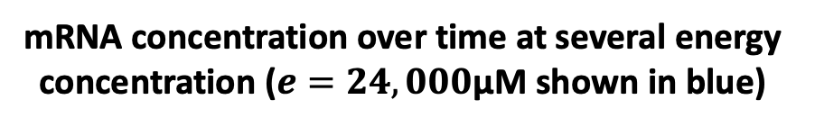
Optimizing a cell-free system
Cell-free optimization: time taken to reach steady-state
mRNA concentration over time at several energy concentration ($e=24,000$µM shown in blue)
Effect of energy concentration on time taken to reach steady state
mRNA Concentration (µM)
Time taken for GFP to reach steady state
Time (hours)
Energy concentration (µM)
Notes:
Lacked accuracy (flatlines)
SS only detected after a full cycle (or multiple cycles depending on how strict the conditions supplied to the algorithm are) have occurred
Various objective values lead to same time taken to reach steady state.

Slide 17
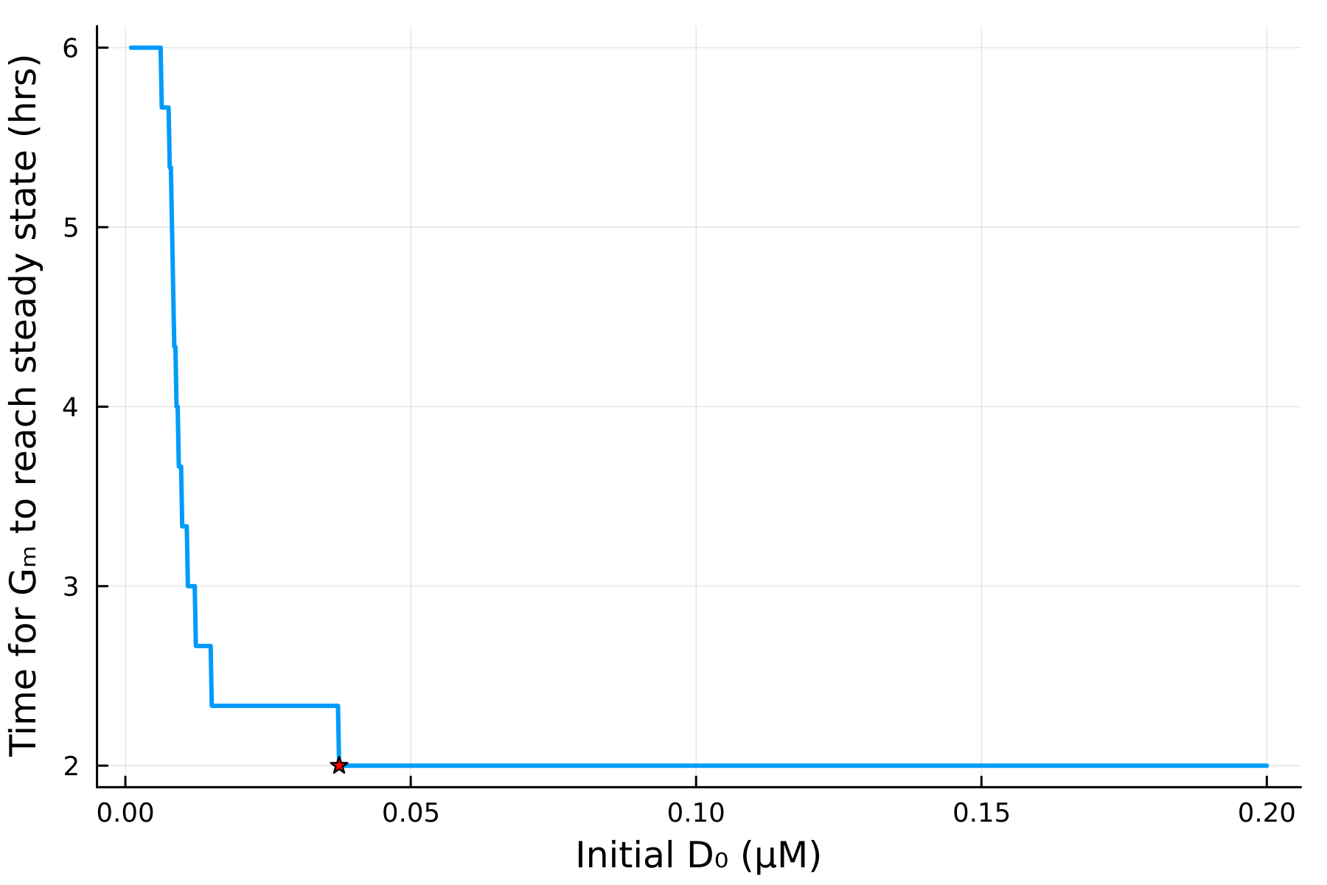
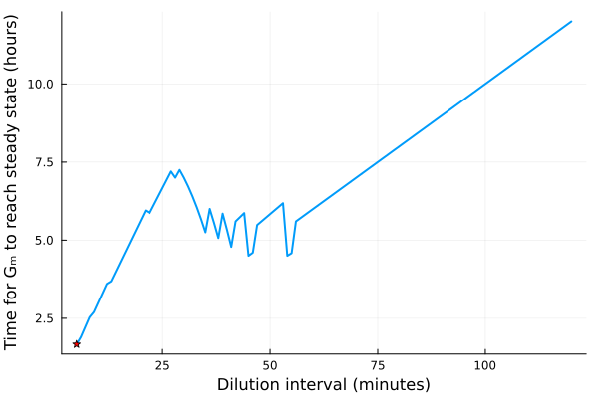
Optimizing a cell-free system
Cell-free optimization: time taken to reach steady-state
Effect of DNA concentration on the time taken for GFP to reach steady state
Effect of dilution interval on the time taken for GFP to reach steady state
Time to steady state (hours)
Time to steady state (hours)
DNA Concentration (µM)
Dilution interval (mins)
Notes:
Lacked accuracy (flatlines)
SS only detected after a full cycle (or multiple cycles depending on how strict the conditions supplied to the algorithm are) have occurred
Various objective values lead to same time taken to reach steady state.

Slide 18
Optimizing a cell-free system
Optimization results
Total GFP Produced
Peak GFP Concentration
Time to Steady State
GFP at Steady State
Original Chemostat
125µM
17.7µM
5.33 hrs
17.5µM
Optimized results
442µM
54.8µM
0.335 hrs
46.4µM
354% increase
310% increase
1524% decrease
265% increase
Notes:
Lacked accuracy (flatlines)
SS only detected after a full cycle (or multiple cycles depending on how strict the conditions supplied to the algorithm are) have occurred
Various objective values lead to same time taken to reach steady state.

Slide 19

Cell-ebrating Efficiency: Optimization Algorithms Meet Biological Systems
Thank you for listening!
Malachy McEvoy | s2277725@ed.ac.uk
Supervision by Dr. Andrea Weisse and Christoph Wagner
Notes:
Moving forward:
Test these findings in a real system
Observe changing volumes – not just fixed at 20µM
Continue to improve our understanding of in vitro TX-TL

